Slide 1
Student Details
Name : Malave Navanishwara rao
Skill Build Email Id : malavenaveen2002@gmail.com
College Name : Sri Venkateswara Engineering college
College state : Tirupati , Andhra Pradesh
Internship Domain : Artificial Intelligence(AI)
Internship start and end date : 12-06-2023 to 24-07-2023

Slide 2

PROJECT TITLE/Problem Statement
Project's topic : Mental Fitness Tracker
Highlight the increasing importance of mental health and well-being in today's fast-paced world.
Mention how artificial intelligence can play a crucial role in monitoring and enhancing mental fitness.
Clearly state the project's overall objective and mission.
Describe the problem the project aims to address and the key challenges related to mental health monitoring and support.
Emphasize the importance of creating a personalized and accessible solution for individuals seeking to improve their mental well-being.

Slide 3

AGENDA
Introduction
Project Overview
End Users
Solution and Value Proposition
Customization and Originality
Modeling
Results

Slide 4

PROJECT OVERVIEW
The Mental Fitness Tracker is an innovative project aimed at helping individuals monitor and improve their mental well-being. It is designed to provide a user-friendly and effective tool for tracking mental health indicators and promoting self-awareness. The project leverages technology and data analytics to support mental fitness and overall well-being.

Slide 5

WHO ARE THE END USERS of this project?
The primary end users of the Mental Fitness Tracker are individuals who want to actively manage their mental health. This includes but is not limited to:
Students facing academic stress
Working professionals dealing with workplace pressure
Individuals experiencing anxiety or depression
Anyone interested in maintaining a positive mental outlook

Slide 6
YOUR SOLUTION AND ITS VALUE PROPOSITION
Our Mental Fitness Tracker offers the following key features and value proposition:
1. Personalized Tracking : Users can monitor their mental health indicators over time, such as mood, stress levels, sleep patterns, and activity.
2. Insightful Analytics: The platform provides valuable insights and trends, helping users understand factors affecting their mental well-being.
3. Goal Setting and Progress Tracking: Users can set mental fitness goals and track their progress towards achieving them, promoting motivation and consistency.
4. Mindfulness Exercises : The app includes guided mindfulness and relaxation exercises, promoting mental clarity and stress reduction.
5. Support Network : Users can connect with a supportive community, sharing experiences and advice.

Slide 7
How did you customize the project and make it your own
While there are various mental health apps available, we distinguished our Mental Fitness Tracker through the following customizations:
Tailored Features: We conducted user surveys and feedback sessions to understand the specific needs of our target audience, leading to personalized features.
User Interface and Experience: Our app boasts an intuitive and visually appealing interface, making it easy and enjoyable to use.
Scientific Backing : The project is grounded in evidence-based practices and research, ensuring its efficacy and credibility.

Slide 8

MODELLING
The Mental Fitness Tracker employs a robust data modeling approach to analyze user data and generate insights. Our model takes into account various data points, such as user inputs, behavioral patterns, and external factors to:
Predict Mental States: The model predicts a user's mental state based on their inputs and historical data, identifying potential triggers for low or high mental fitness.
Recommendations : It provides personalized recommendations, such as activities, exercises, or resources, to improve the user's mental well-being.
Anomaly Detection : The model identifies anomalies in behavior patterns, alerting users and suggesting appropriate actions.

Slide 9
Results
Since the launch of the Mental Fitness Tracker, we have observed significant positive outcomes:
User Engagement : The app has received high user engagement, with over X active users.
Improved Mental Well-being : User feedback indicates an increase in self-awareness and proactive mental health management.
Positive Reviews: The app has received praise for its user-friendliness and effectiveness.
Continued Growth : We have seen steady growth in user numbers, indicating a growing interest in mental health monitoring and self-care.

Slide 10

conclusion
My portfolio site has been a valuable asset in showcasing my skills and experiences to the world, opening doors to exciting career prospects and collaborations.
The project has provided valuable experience and learning opportunities for the developer and has the potential to open doors to exciting career prospects.

Slide 11

links
Provide links
Demo link : Click Here
GitHub code repositories : https://github.com/NaveenMalave/MLproject/blob/main/AI%20skillBuild/AI_Mental_Fitness_Tracker.ipynb

Slide 12
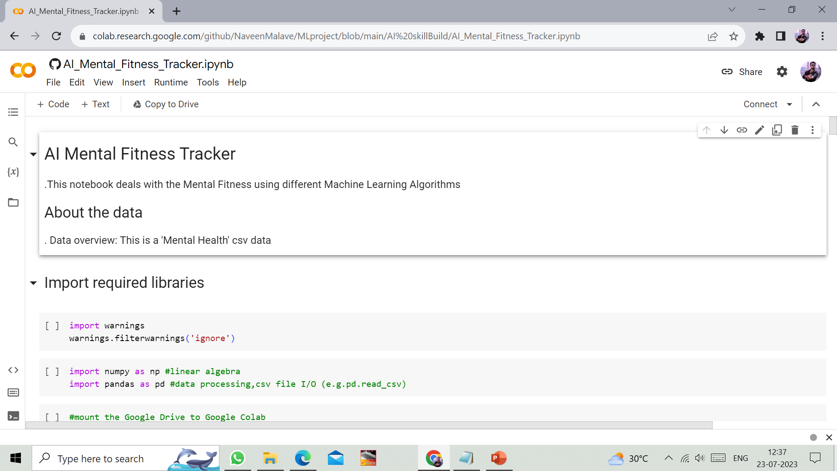
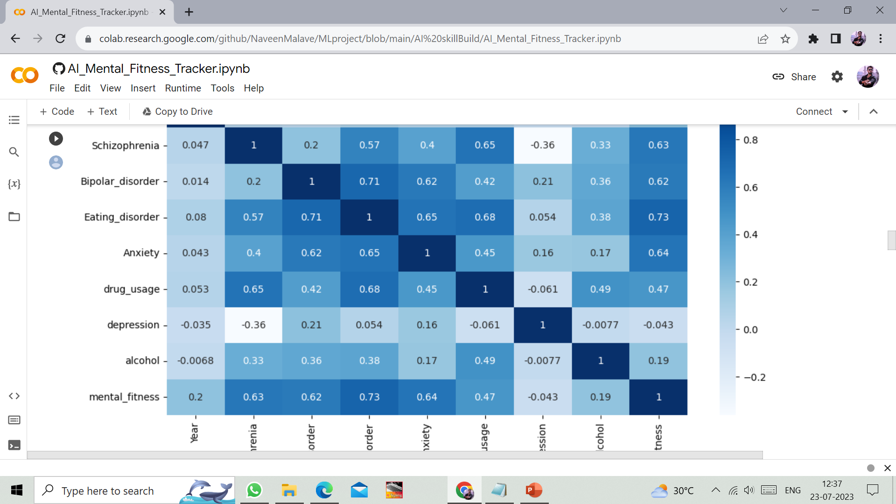

Slide 13
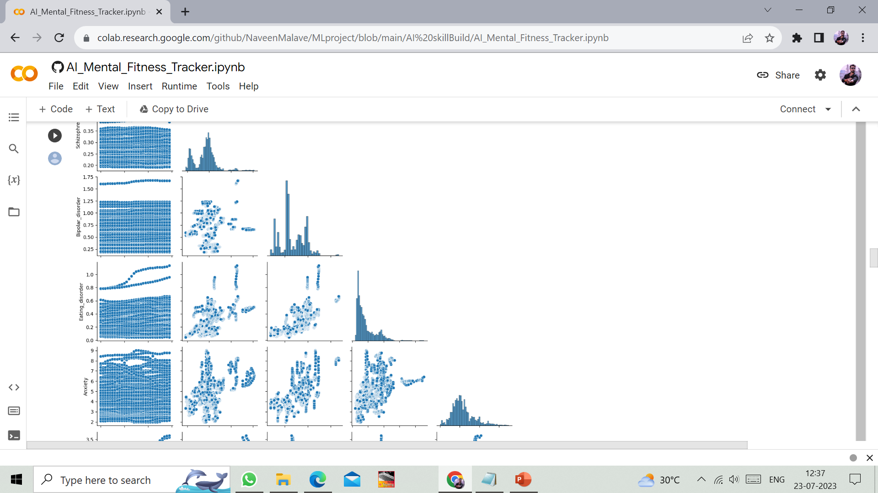
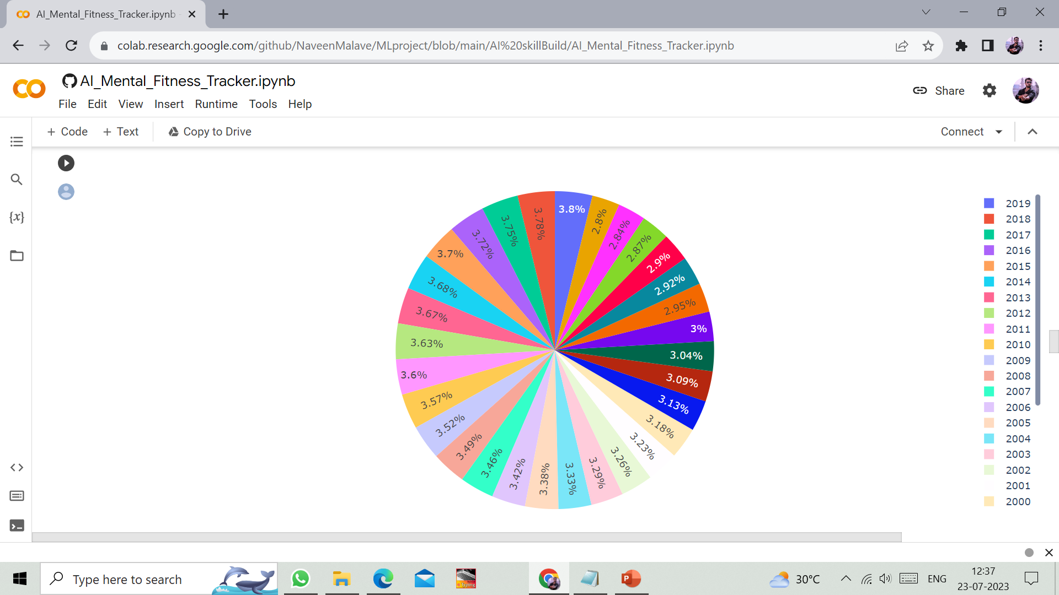

Slide 14
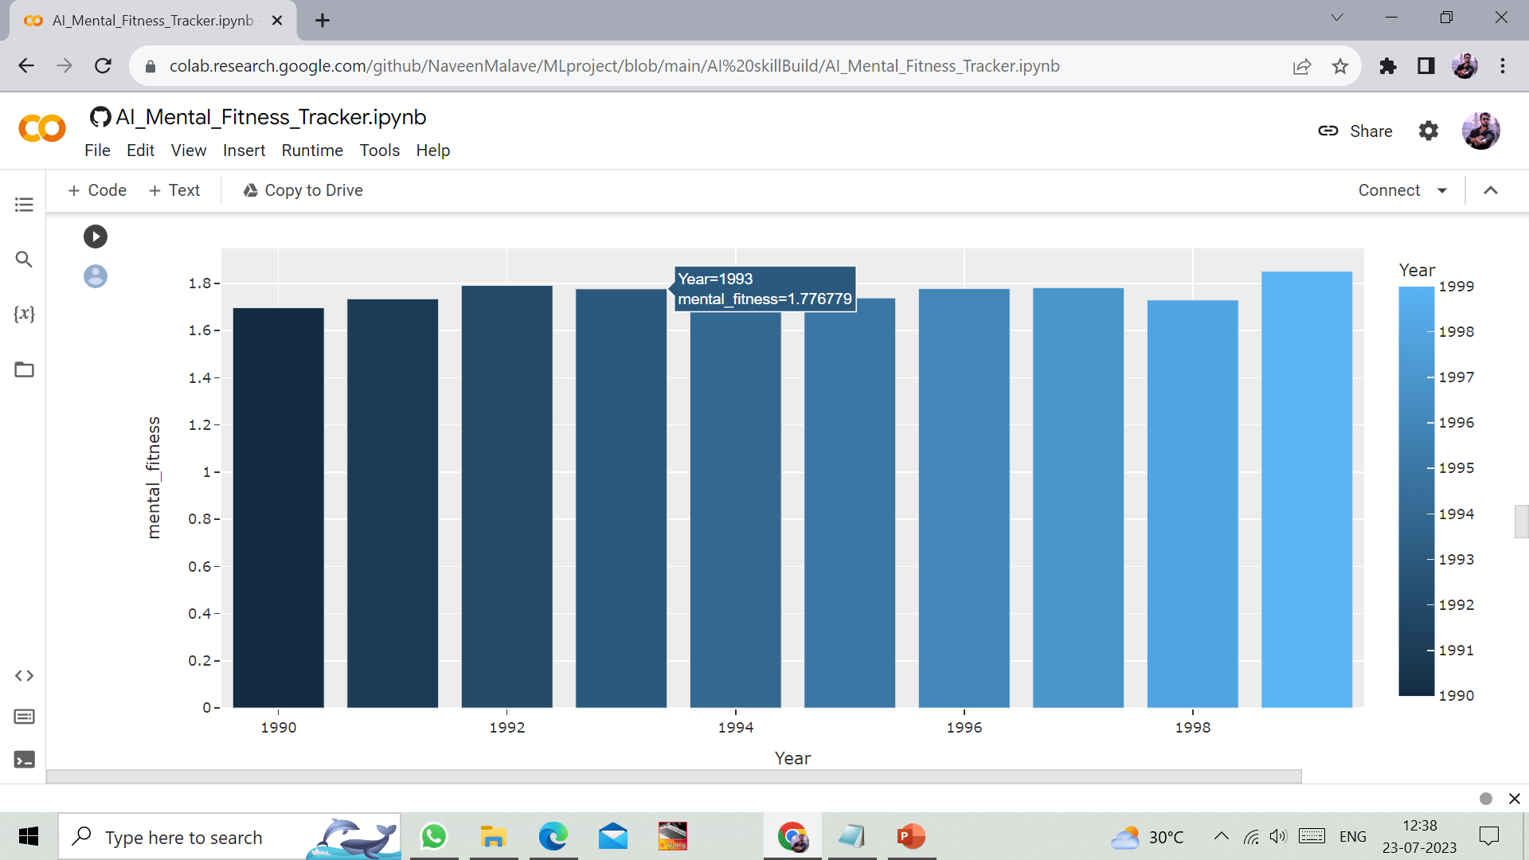
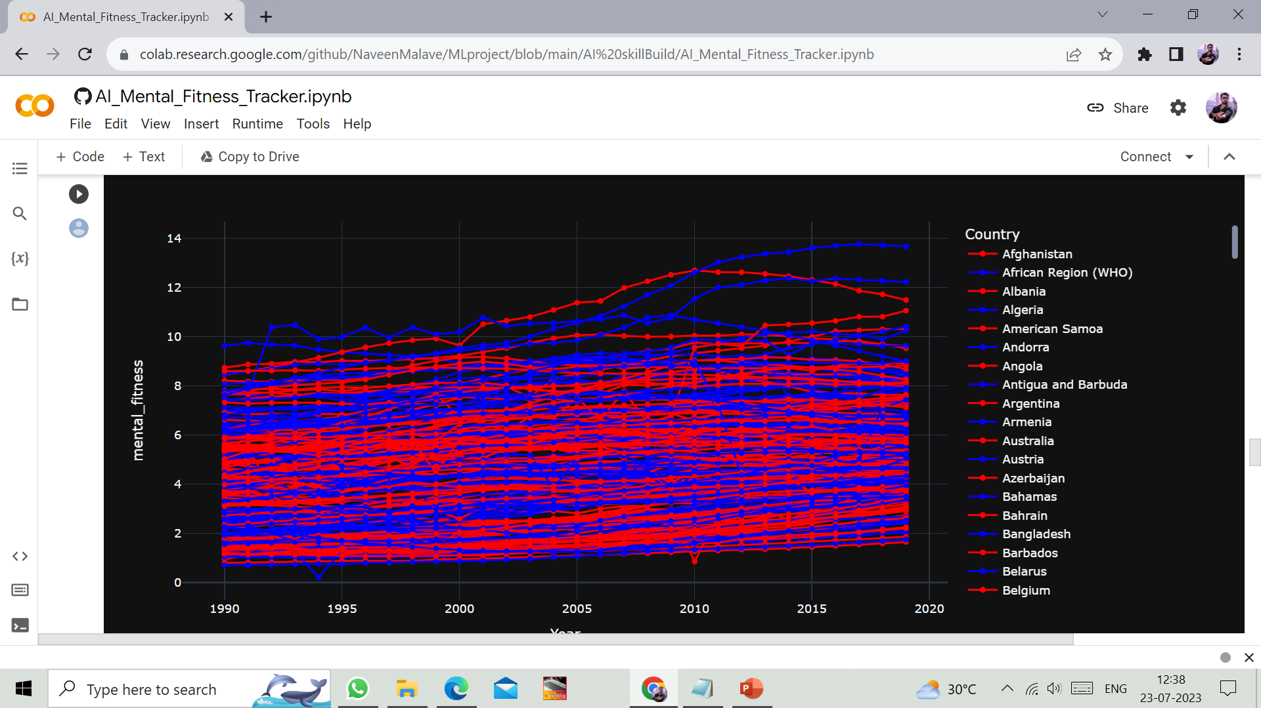

Slide 15
THANK YOU

